Slide 1
CogniFlow AI
An intelligent multi-agent assistant that detects cognitive load and intervenes with precision. No diagnosis required.

Slide 2
Problem
Neurodivergent professionals don't struggle with the work itself. They struggle with doing the work while simultaneously performing neurotypicality.
1 in 5 tech professionals is neurodivergent
30–40% of working memory consumed by masking
No existing tool detects or addresses this cost

Slide 3
The People We Built This For
Sofia: ADHD · Executive Load
Gets stuck mid-task, loses context, can't re-enter.
"Deficits in behavioral inhibition impair the ability to re-engage with interrupted tasks." Barkley (1997), Executive Functions
MTI proxy: keystroke latency > 2000ms + abandonment signals MTI baseline: 71
Ana: Autism · UX Designer
Freezes on ambiguous messages, delays responses for hours.
"Camouflaging autistic traits requires continuous social monitoring, consuming working memory resources otherwise available for task performance." Hull et al. (2017), CAT-Q
MTI proxy: section returns > 4 + high latency variance MTI baseline: 64
Miguel: Dyslexia · Data Analyst
Re-reads the same paragraph 4–5 times before acting.
"Phonological loop overload reduces reading comprehension and increases re-reading frequency in adults with dyslexia." Baddeley (2003), Working Memory Model
MTI proxy: high revision frequency + scroll without progression
MTI baseline: 58

Slide 4
CogniFlow Solution
MASKING TAX INDEX
A proprietary metric calculated from behavioral proxies: keystroke latency, revision frequency, section returns, and abandonment signals. No form. No declaration. No diagnosis.
THE APPROACH
7 specialized AI agents monitor, classify, and intervene in real time across three professional surfaces: text editor, inbox, and task manager.

Slide 5
How it Works
DETECT
CLASSIFY
INTERVENE
CogniFlow monitors keystroke latency, revision frequency, section returns, and abandonment signals passively. No interruption, no form, no question asked.
CogniFlow classifies the active cognitive load type: executive, phonological, contextual, mixed, or neutral, with a confidence score updated in real time.
FocusAgent fragments executive tasks into time-anchored steps. ContextAgent makes implicit communication explicit. PhonAgent adapts typography and pacing. BlendIt orchestrates when multiple loads are active. CalmGuard validates every output before it reaches the user. NotifyAgent delivers suggestions only in optimal cognitive windows.

Slide 6
The 7 Agents
ProfileSense: Classifies cognitive load type from behavioral signals, no diagnosis required.
FocusAgent: Fragments executive tasks into time-anchored micro-steps for ADHD profiles.
ContextAgent: Makes implicit communication explicit for autism profiles.
PhonAgent: Adapts typography and reading pacing for dyslexia profiles.
BlendIt: Orchestrates agent conflicts when multiple cognitive loads are active simultaneously.
CalmGuard: Validates every agent output before it reaches the user. RAI structural layer.
NotifyAgent: Delivers interventions only in optimal cognitive windows. Maximum 4 per day. Blocked when MTI > 60.

Slide 7
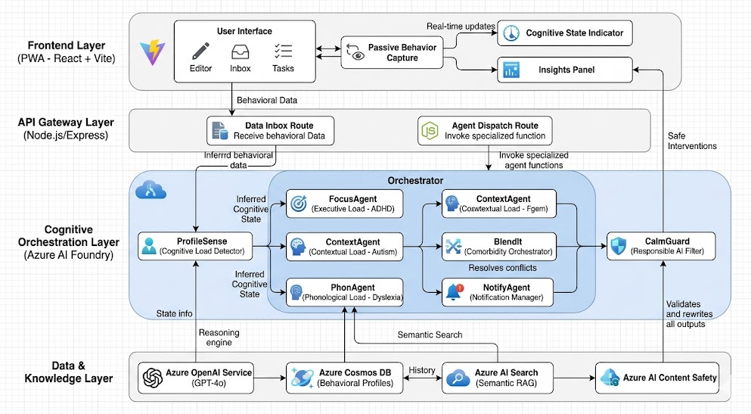
Architecture

Slide 8
Azure Services
Azure AI Foundry · Central hub for all 7 agents
Azure OpenAI · GPT-4.1 mini inference engine
Azure AI Search · RAG + behavioral index enrichment
Azure Cosmos DB · Behavioral profiles + session events
Azure Content Safety · CalmGuard real-time filter
Azure Notification Hubs · Web Push delivery via NotifyAgent
Azure API Management · Gateway + rate limiting
Azure Key Vault · Credentials and secrets management
Azure Monitor · RAI audit log + intervention tracking
Azure App Service · Backend + PWA deployment

Slide 9
Responsible AI
FAIRNESS + INCLUSIVENESS
RELIABILITY + PRIVACY
TRANSPARENCY + ACCOUNTABILITY
Works without diagnosis or self-declaration. No accessibility mode toggle.
CalmGuard validates every output. Key Vault protects all credentials. Behavioral data classified as sensitive.
Audit log of every intervention. Every action is reversible. Granular opt-out available.

Slide 10
Impact
−52% MTI reduction
per session
(Sofia · editor)
−50% Response decision time
(Ana · inbox)
0 Diagnoses required
CogniFlow gives back the working memory that masking steals.

Slide 11
Thank You!
CogniFlow AI
Erika Barrado
Letícia Batista Silva

